Slide 1

Object Oriented System Analysis
Chapter 6

Slide 2
What is object orientation?
In the object-oriented approach, the focus is on capturing the structure and behavior of information systems into small modules that combines both data and process.
main aim of Object Oriented Design (OOD) is to improve the quality and productivity of system analysis and design by making it more usable.
In analysis phase, OO models are used to fill the gap between problem and solution.
It performs well in situation where systems are undergoing continuous design, adaption, and maintenance.
It identifies the objects in problem domain, classifying them in terms of data and behavior.

Slide 3
What is object orientation?...
The OO model is beneficial in the following ways
It facilitates changes in the system at low cost.
It promotes the reuse of components.
It simplifies the problem of integrating components to configure large system.
It simplifies the design of distributed systems

Slide 4
What is object orientation?...
the characteristics of OO System
Objects is something that is exists within problem domain and can be identified by data (attribute) or behavior. All tangible entities (student, patient) and some intangible entities (bank account) are modeled as object.
Attributes − They describe information about the object.
Behavior − It specifies what the object can do. It defines the operation performed on objects.
Class − A class encapsulates the data and its behavior. Objects with similar meaning and purpose grouped together as class.
Methods − Methods determine the behavior of a class. They are nothing more than an action that an object can perform.
Message − A message is a function or procedure call from one object to another. They are information sent to objects to trigger methods. Essentially, a message is a function or procedure call from one object to another.

Slide 5
What is object orientation?...
Features of Object-Oriented System
Encapsulation
is a process of information hiding. It is simply the combination of process and data into a single entity.
Data of an object is hidden from the rest of the system and available only through the services of the class.
It allows improvement or modification of methods used by objects without affecting other parts of a system.

Slide 6
What is object orientation?...
Features of Object-Oriented System
Abstraction
It is a process of taking or selecting necessary method and attributes to specify the object.
It focuses on essential characteristics of an object relative to perspective of user.

Slide 7
What is object orientation?...
Features of Object-Oriented System
Relationships
All the classes in the system are related with each other.
The objects do not exist in isolation, they exist in relationship with other objects
There are three types of object relationships
Aggregation − It indicates relationship between a whole and its parts.
Association − In this, two classes are related or connected in some way such as one class works with another to perform a task or one class acts upon other class.
Generalization − The child class is based on parent class. It indicates that two classes are similar but have some differences.

Slide 8
What is object orientation?...
Features of Object-Oriented System
Inheritance
is a great feature that allows to create sub-classes from an existing class by inheriting the attributes and/or operations of existing classes.
Polymorphism and Dynamic Binding
is the ability to take on many different forms.
It applies to both objects and operations.
A polymorphic object is one who true type hides within a super or parent class.
In polymorphic operation, the operation may be carried out differently by different classes of objects.
It allows us to manipulate objects of different classes by knowing only their common properties.

Slide 9
Model
A model is a simplification at some level of abstraction
We build models to better understand the systems we are developing.

Slide 10
Model…
Why do we model?
Helps us to visualize a system as we want it to be.
Permits us to specify the structure or behavior of a system.
Gives us a template that guides us in constructing a system.
To document decisions we have made

Slide 11
Principles of Modeling
The choice of what models to create has a profound influence on how a problem is attacked and how a solution is shaped.
Choose your models well. The right models will highlight the most nasty development problems. Wrong models will mislead you, causing you to focus on irrelevant issues.
Every model may be expressed at different levels of precision.
Sometimes, a quick and simple executable model of the user interface is exactly what you need. At other times, you have to get down to complex details such as cross-system interfaces or networking issues etc.
In any case, the best kinds of models are those that let you choose your degree of detail, depending on who is viewing it. An analyst or an end user will want to focus on issues of what and a developer will want to focus on issues of how.

Slide 12
Principles of Modeling…
The best models are connected to reality
In software, the gap between the analysis model and the system’s design model must be less. Failing to bridge this gap causes the system to diverge over time. In object-oriented systems, it is possible to connect all the nearly independent views of a system into one whole.
No single model is sufficient. Every non-trivial system is best approached through a small set of nearly independent models.

Slide 13
Object oriented modeling
Object-oriented modeling (OOM) is the construction of objects using a collection of objects that contain stored values of the instance variables found within an object.
Unlike models that are record-oriented, object-oriented values are solely objects.
The object-oriented modeling approach creates the union of the application and database development and transforms it into a unified data model and language environment.
Object-oriented modeling allows for object identification and communication while supporting data abstraction, inheritance and encapsulation

Slide 14
Object oriented modeling…
The software life cycle is typically divided up into stages going from abstract descriptions of the problem to designs then to code and testing and finally to deployment.
Modeling is done at the beginning of the process.
The reasons to model a system before writing the code are:
Communication: Users typically cannot understand programming language or code.
Model diagrams can be more understandable and can allow users to give developers feedback on the appropriate structure of the system.
A key goal of the Object-Oriented approach is to decrease the "semantic gap" between the system and the real world by using terminology that is the same as the functions that users perform

Slide 15
Object oriented modeling…
The reasons to model a system before writing the code are:
Abstraction: goal of most software methodologies is to first address "what" questions and then address "how" questions. I.e., first determine the functionality the system is to provide without consideration of implementation constraints and then consider how to take this abstract description and refine it into an implementable design and code given constraints such as technology and budget.
Modeling enables this by allowing abstract descriptions of processes and objects that define their essential structure and behavior.
Object-oriented modeling is typically done via use case and abstract definitions of the most important objects.
The most common language used to do object-oriented modeling is the Object management Group’s Unified Modeling Language (UML)

Slide 16
Overview of UML
UML was created by the Object Management Group (OMG) and UML 1.0 specification draft was proposed to the OMG in January 1997.
UML stands for Unified Modeling Language.
UML is different from the other common programming languages such as C++, Java, COBOL, etc.
UML is a pictorial language used to make software blueprints.
UML can be described as a general purpose visual modeling language to visualize, specify, construct, and document software system.
Although UML is generally used to model software systems, it is not limited within this boundary. It is also used to model non-software systems as well. For example, the process flow in a manufacturing unit, etc.

Slide 17
Overview of UML…
Goals of UML
Provide users with a ready-to-use, expressive visual modeling language so they can develop and exchange meaningful models
Provide extensibility and specialization mechanisms to extend the core concepts
Be independent of particular programming languages and development processes
Provide a formal basis for understanding the modeling language
Encourage the growth of the OO tools market
Support higher-level development concepts such as collaborations, frameworks, patterns and components
Integrate best practices

Slide 18
Overview of UML…
Building Blocks of the UML
The vocabulary of the UML encompasses three kinds of building blocks
Things
Relationships
Diagrams

Slide 19
Overview of UML…
Things
Things are the abstractions that are first-class citizens in a model; relationships tie these things together; diagrams group interesting collections of things.
There are 4 kinds of things in the UML:
Structural things
Behavioral things
Grouping things
Annotional things
These things are the basic object-oriented building blocks of the UML. You use them to write well-formed models.

Slide 20
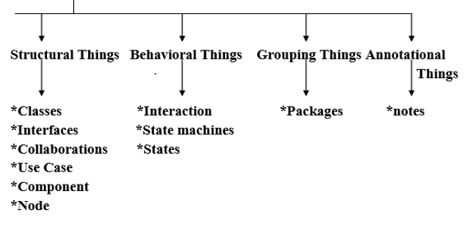
Overview of UML…
Things

Slide 21
Overview of UML…
Structural things are the nouns of UML models.
These are the mostly static parts of a model, representing elements that are either conceptual or physical.
Collectively, the structural things are called classifiers.

Slide 22
Overview of UML…
Behavioral things are the dynamic parts of UML models.
These are the verbs of a model, representing behavior over time and space.
Grouping things are the organizational parts of UML models.
These are the boxes into which a model can be decomposed. There is one primary kind of grouping thing, namely, packages.

Slide 23
Overview of UML…
Annotational things are the explanatory parts of UML models.
These are the comments you may apply to describe, illuminate, and remark about any element in a model.
There is one primary kind of annotational thing, called a note.
A note is simply a symbol for rendering constraints and comments attached to an element or a collection of elements.
Graphically, a note is rendered as a rectangle with a dog-eared corner, together with a textual or graphical comment

Slide 24
Overview of UML…
Relationships
There are 4 kinds of relationships in the UML:
Dependency
Association
Generalization
Realization
These relationships are the basic relational building blocks of the UML

Slide 25
Overview of UML…
Student
University
attends
1. Associations
Structural relationship that describes a set of links, a link being a connection between objects.
variants: aggregation & composition
Student
Person
2. Generalization
a specialized element (the child) is more specific the generalized element.
Student
3. Realization
one element guarantees to carry out what is expected by the other element.
(e.g, interfaces and classes/components; use cases and collaborations)
IGrade
harry: Student
<<instanceOf>>
Student
4. Dependency
a change to one thing (independent) may affect the semantics of the other thing (dependent).
(direction, label are optional)

Slide 26
Overview of UML…
Diagrams
It is the graphical presentation of a set of elements. It is rendered as a connected graph of vertices (things) and arcs (relationships).
In theory, a diagram may contain any combination of things and relationships.
Class diagram
Object diagram
Use case diagram
Sequence diagram
Collaboration diagram
State chart diagram
Activity diagram
Component diagram
Deployment diagram

Slide 27
Overview of UML…
Rules: The UML has a number of rules that specify what a well-formed model should look like.
A well-formed model is one that is semantically self-consistent and in harmony with all its related models.
The UML has semantic rules for:
Names – What you can call things, relationships, and diagrams.
Scope – The context that gives specific meaning to a name.
Visibility – How those names can be seen and used by others.
Integrity – How things properly and consistently relate to one another.

Slide 28
Use Case Diagrams
What is a Use Case
A formal way of representing how a business system interacts with its environment
Illustrates the activities that are performed by the users of the system
A scenario-based technique in the UML

Slide 29
Use Case …
What is an Actor?
A user or outside system that interacts with the system being designed in order to obtain some value from that interaction
Use Cases describe scenarios that describe the interaction between users of the system (the actor) and the system itself.

Slide 30
Use Cases …
Use case diagrams describe what a system does from the standpoint of an external observer.
The emphasis is on what a system does rather than how.
Use case diagrams are closely connected to scenarios.
A scenario is an example of what happens when someone interacts with the system.

Slide 31
Use Cases …
Here is a scenario for a medical clinic.
A patient calls the clinic to make an appointment for a yearly checkup. The receptionist finds the nearest empty time slot in the appointment book and schedules the appointment for that time slot. "
We want to write a use case for this scenario.
Remember: A use case is a summary of scenarios for a single task or goal.

Slide 32
Use Cases ...
Step 1 Identify the actors
Define those people or systems that are going to interact with the scenario.
A patient calls the clinic to make an appointment for a yearly checkup. The receptionist finds the nearest empty time slot in the appointment book and schedules the appointment for that time slot. "

Slide 33
Use Cases …
Questions for Identifying People Actors
Who is interested in the scenario/system?
Where in the organization is the scenario/system be used?
Who will benefit from the use of the scenario/system?
Who will supply the scenario/system with this information, use this information, and remove this information?
Does one person play several different roles?
Do several people play the same role?
Notes:
Actors
7) Does one person play several different roles?
May have an actor for each role
8) Do several people play the same role?
Only use one actor per role (no matter how many people play that role)
Identifying actors is an iterative process
Defining how an actor interacts with the system may clarify whether there are duplicate actors or not

Slide 34
Use Cases …
Questions for Identifying People Actors
What other entity is interested in the scenario/system?
What other entity will supply the scenario/system with this information, use this information, and remove this information?
Does the system use an external resource?
Does the system interact with a legacy system?
Notes:
Actors
7) Does one person play several different roles?
May have an actor for each role
8) Do several people play the same role?
Only use one actor per role (no matter how many people play that role)
Identifying actors is an iterative process
Defining how an actor interacts with the system may clarify whether there are duplicate actors or not

Slide 35
Actors
An Actor is outside or external the system.
It can be a:
Human
Peripheral device (hardware)
External system or subsystem
Time or time-based event
Represented by stick figure
Notes:
Actors
Are NOT a part of the system (external to the system)
A single actor may represent multiple physical users
Whether human or not, represented by stick figure
MUST label stick figure with the name of the actor

Slide 36
Use Cases
A use case is a summary of scenarios for a single task or goal.
An actor is who or what initiates the events involved in the task of the use case. Actors are simply roles that people or objects play.
So as we read our scenario, what or who is the actor????

Slide 37

Use Cases
So as we read our scenario, what or who is the actor????
A patient calls the clinic to make an appointment for a yearly checkup. The receptionist finds the nearest empty time slot in the appointment book and schedules the appointment for that time slot. "
The actor is a Patient.

Slide 38
Use Cases
The use case is a summary of scenarios for a single task or goal.
So What is the Use Case????
The Use Case is Make Appointment.
It is a use case for the medical clinic.

Slide 39

Use Cases
The picture below is a Make Appointment use case for the medical clinic.
The actor is a Patient. The connection between actor and use case is a communication association (or communication for short).
Actors are stick figures.
Use cases are ovals.
Communications are lines that link actors to use cases.

Slide 40
Use Case Components
The use case has three components.
The use case task referred to as the use case that represents a feature needed in a software system.
The actor(s) who trigger the use case to activate.
The communication line to show how the actors communicate with the use case.

Slide 41
Use Case Diagram - Use Case
A major process performed by the system that benefits an actor(s) in some way
Models a dialogue between an actor and the system
Represents the functionality provided by the system
Notes:
Use Case
Represent the user functionality (not system functionality)

Slide 42
Use Case
Each use case in a use case diagram describes one and only one function in which users interact with the system
May contain several “paths” that a user can take while interacting with the system
Each path is referred to as a scenario
Notes:
Use Case
In reading a use case, you should not be able to tell if an activity is computerized or manual
Used to document the current system (AS-IS system) or the new system being developed (TO-BE system)
Communicates at a high level what the system needs to do
Captures the typical interaction of the system with the system’s users
Logical model
Physical details are defined during the design phase

Slide 43
Use Case
Labelled using a descriptive verb-noun phrase
Represented by an oval
Make
Appointment
Notes:
Use case: A use case in a use case diagram is a visual representation of a distinct business functionality in a system. The key term here is "distinct business functionality." To choose a business process as a likely candidate for modeling as a use case, you need to ensure that the business process is discrete in nature. As the first step in identifying use cases, you should list the discrete business functions in your problem statement. Each of these business functions can be classified as a potential use case. Remember that identifying use cases is a discovery rather than a creation. As business functionality becomes clearer, the underlying use cases become more easily evident. A use case is shown as an ellipse in a use case diagram Depicted by an oval
MUST label the oval with the name of the use case

Slide 44
Use Case - Actor
Labelled using a descriptive noun or phrase
Represented by a stick character
Notes:
Actors: An actor portrays any entity (or entities) that performs certain roles in a given system. The different roles the actor represents are the actual business roles of users in a given system. An actor in a use case diagram interacts with a use case. For example, for modeling a banking application, a customer entity represents an actor in the application. Similarly, the person who provides service at the counter is also an actor. But it is up to you to consider what actors make an impact on the functionality that you want to model. If an entity does not affect a certain piece of functionality that you are modeling, it makes no sense to represent it as an actor. An actor is shown as a stick figure in a use case diagram depicted "outside" the system boundary, as shown in Make Appointment figure.
Depicted by an oval
MUST label the oval with the name of the use case
To identify an actor, search in the problem statement for business terms that portray roles in the system. For example, in the statement "patients visit the doctor in the clinic for medical tests," "doctor" and "patients" are the business roles and can be easily identified as actors in the system.

Slide 45
Use Case - Relationships
Relationships
Represent communication between actor and use case
Depicted by line or double-headed arrow line
Also called association relationship
Other Relationship
Generalization
Include
Extend
Make
Appointment
Notes:
Use Case Relationship
Association relationship
May exist between actor and a use case
Often referred to as a communicate association
Navigable in both directions (actor to use case and use case to actor)
Some use just a line
Others use a double-headed arrowhead
Navigable in only one direction (actor to use case OR use case to actor)
Use a arrowhead where arrowhead denotes the direction of communication
Navigation direction of an association represents who is initiating the communication
Multiplicity
Not consistency shown on all use-case diagrams (Some do; some don’t)

Slide 46
Use Case - Relationships
Boundary
defines the scope of what a system will be
A boundary rectangle is placed around the perimeter of the system to show how the actors communicate with the system.
Make
Appointment
Notes:
System boundary: A system boundary defines the scope of what a system will be. A system cannot have infinite functionality. So, it follows that use cases also need to have definitive limits defined. A system boundary of a use case diagram defines the limits of the system. The system boundary is shown as a rectangle spanning all the use cases in the system.
Other use cases in this lecture also show the system boundary of the clinic application. The use cases of this system are enclosed in a rectangle. Note that the actors in the system are outside the system boundary.
The system boundary is potentially the entire system as defined in the problem statement. But this is not always the case. For large and complex systems, each of the modules may be the system boundary. For example, for an ERP system for an organization, each of the modules such as personnel, payroll, accounting, and so forth, can form the system boundary for use cases specific to each of these business functions. The entire system can span all of these modules depicting the overall system boundary.

Slide 47
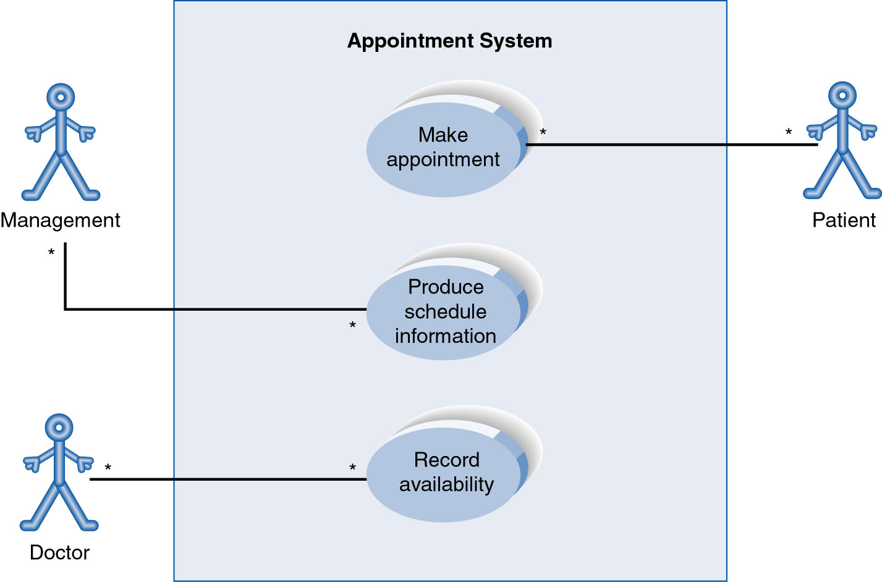
Use-Case Diagram
A use case diagram is a collection of actors, use cases, and their communications.
Notes:
Example Use Case
ACTORS
Represented by a stick figure
named
USE CASE
Represented by an oval
Named (POORLY NAMED; should be verb phrase)
RELATIONSHIP
2-way association

Slide 48
Use Case Diagram
Other Types of Relationships for Use Cases
Generalization
Include
Extend
Notes:
Inheritance

Slide 49
Components of Use Case Diagram
Generalization Relationship
Represented by a line and a hollow arrow
From child to parent
Child use case
Parent use case
Notes:
Inheritance
A use case generalization shows that one use case is simply a special kind of another.
A clinic may have a use case such as Pay Bill which would be a parent use case and Bill Insurance which is the child.
A child can be substituted for its parent whenever necessary.
Generalization appears as a line with a triangular arrow head toward the parent use case.

Slide 50
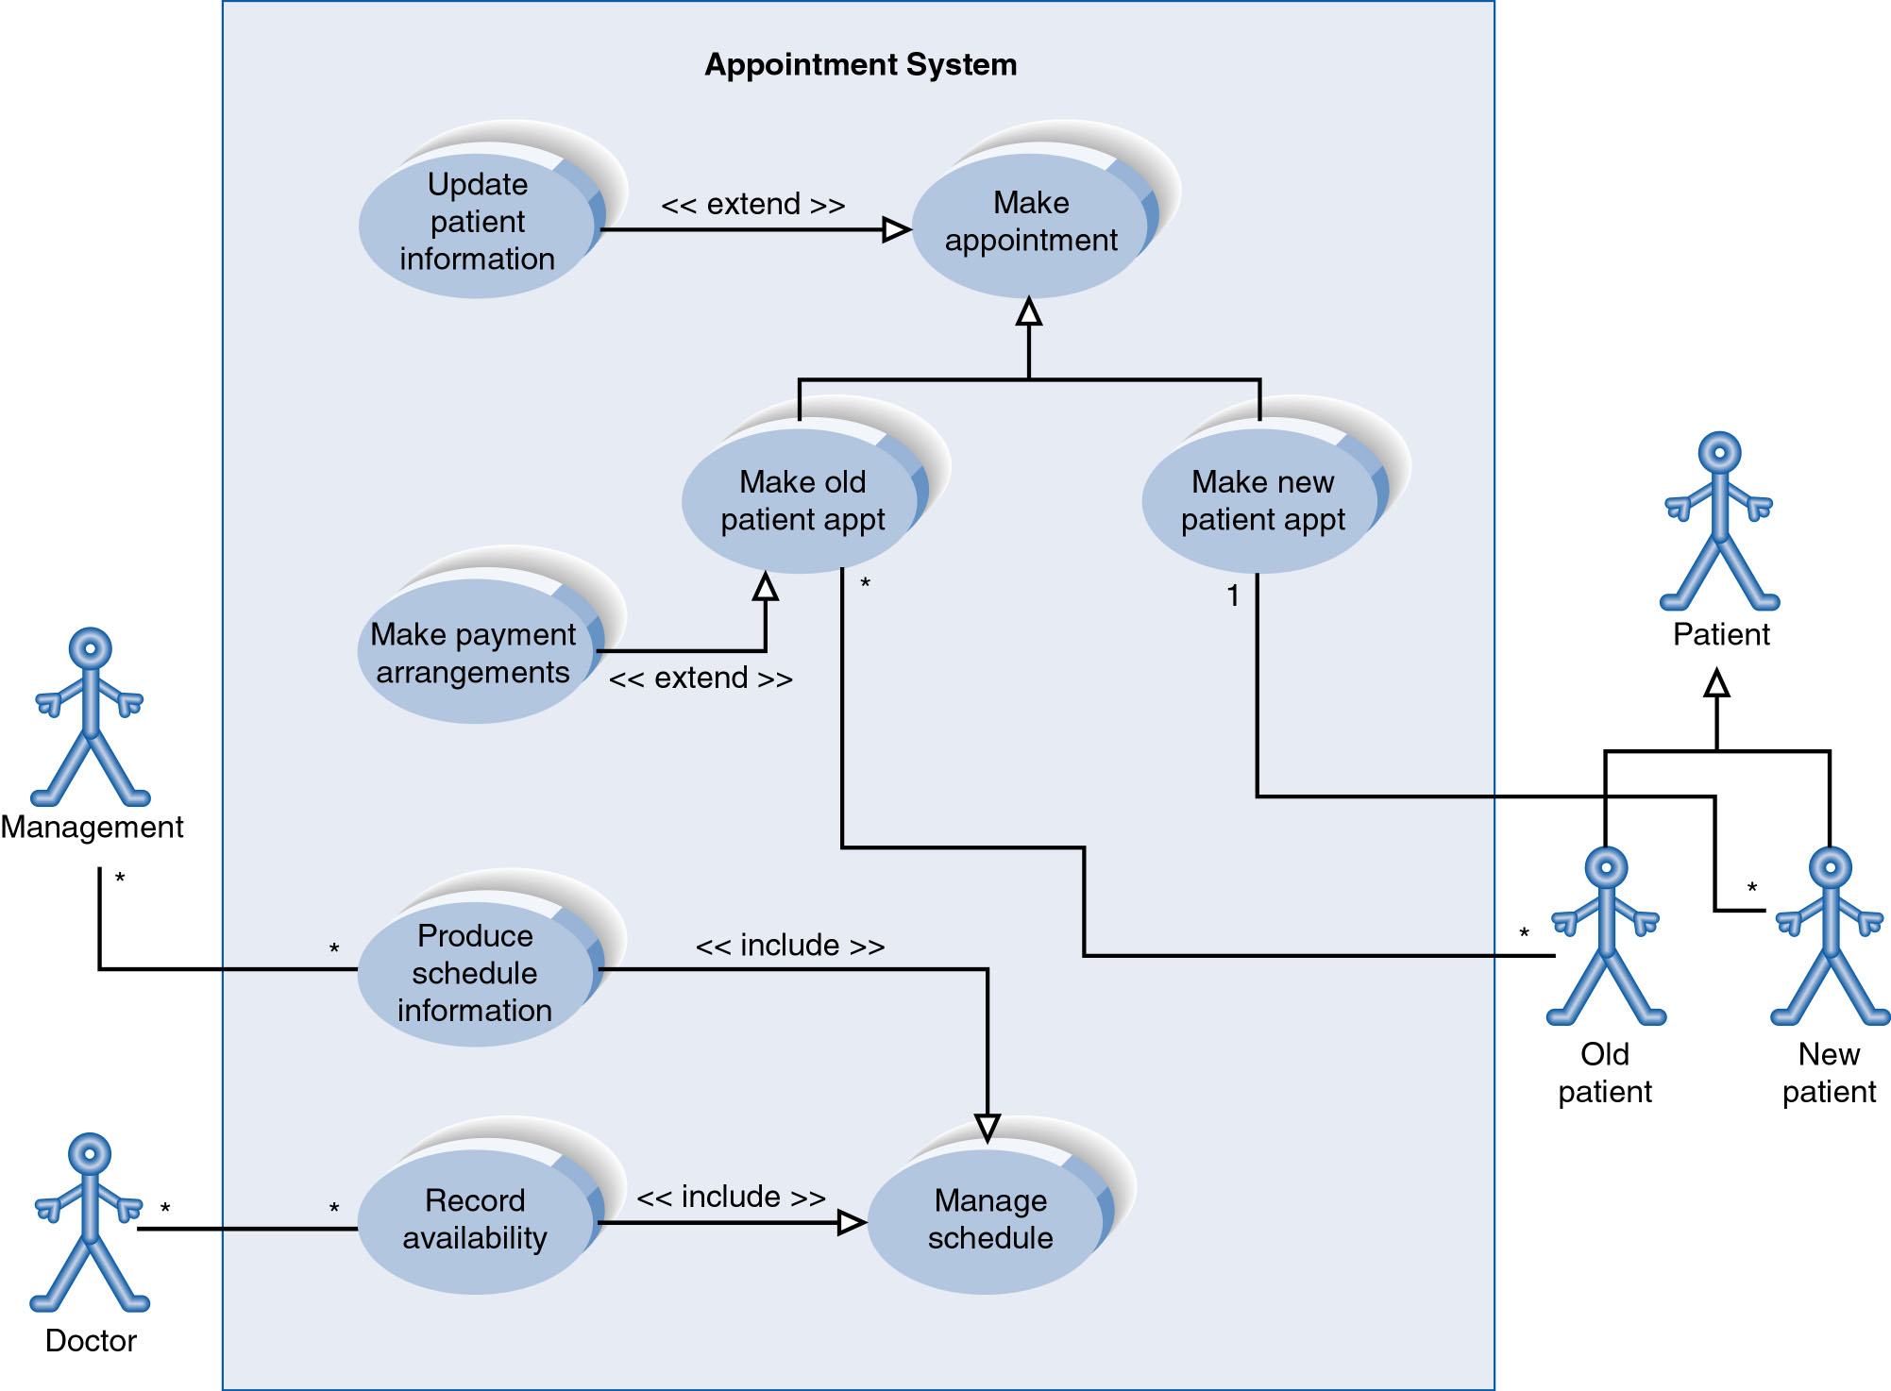
Example of Relationships
Notes:
System Boundary
Use cases are enclosed within a system boundary
a box that represents the system and clearly delineates what parts of the diagram are external or internal to it
Name of the system can appear inside or on top of the box

Slide 51
Use Case Diagram
Include Relationship
Represents the inclusion of the functionality of one use case within another
Arrow is drawn from the base use case to the used use case
Write << include >> above arrowhead line
Notes:
Include relationship
Notice that ONLY between use cases (not between actors)
MANDATORY functional
Multiple use cases may share pieces of the same functionality
Rather than have duplicate functionality in several use cases
Put shared functionality in one use case and show relationship between it and other use cases that “uses” its functionality
Depicted by arrowhead with word “<<include>>” above it
Include relationships factor use cases into additional ones.
Includes are especially helpful when the same use case can be factored out of two different use cases.
If a clinic had a cases of Make Appointment and Request Medication.
Both might include Check Patient Record as a subtask.
Both would include a call to the use case Check Patient Record.
We don’t want to write it twice we simply want to include in as a call from both.
In the diagram,
include notation is a dotted line beginning at base use case ending with an arrows pointing to the include use case.
The dotted line is labeled <<include>>.

Slide 52
Use Case Diagram
Extend relationship
Represents the extension of the use case to include optional functionality
Arrow is drawn from the extension use case to the base use case
Write << extend >> above arrowhead line
Notes:
Use Case Relationship
Extend relationship
Used to show optional behavior (behavior that is run only under certain circumstances)
Depicted by arrowhead with word “<<extend>>” above it
An extend relationship indicates that one use case is a variation of another.
This is often used when much of the same code may be in both only one extends the functionality somewhat.
A typical example is a add record to the database and modify that record.
So an add student is similar to a modify student so I may reuse some of the code.
Extend notation is a dotted line, labeled <<extend>>, and with an arrow toward the base case.
The extension point, which determines when the extended case is appropriate, is written inside the base case.

Slide 53
Example of Relationships
Notes:
System Boundary
Use cases are enclosed within a system boundary
a box that represents the system and clearly delineates what parts of the diagram are external or internal to it
Name of the system can appear inside or on top of the box

Slide 54
Use Cases Identification Techniques
Three techniques for Identifying use cases
User goal technique
Event decomposition technique
CRUD
Name each use case using Verb-Noun

Slide 55
1. User Goal Technique
This technique is the most common in industry
Simple and effective
Identify all of the potential categories of users of the system
Interview and ask them to describe the tasks the system can help them with
E.g, “I need to Ship items, Track a shipment, Create a return”

Slide 56
1. User Goal Technique Example

Slide 57
1. User Goal Technique: Specific Steps
Identify all the potential users for the new system
Classify the potential users in terms of their functional role (e.g., shipping, marketing, sales)
Further classify potential users by organizational level (e.g., operational, management, executive)
For each type of user, interview them to find a list of specific goals they will have when using the new system (current goals and innovative functions to add value)

Slide 58
1. User Goal Technique Specific Steps …
Create a list of preliminary use cases organized by type of user
Look for duplicates with similar use case names and resolve inconsistencies
Identify where different types of users need the same use cases
Review the completed list with each type of user and then with interested stakeholders

Slide 59
2. Event Decomposition Technique
More Comprehensive and Complete Technique
Identify the events that occur to which the system must respond.
For each event, name a use case (verb-noun) that describes what the system does when the event occurs
Event– something that occurs at a specific time and place, can be described, and should be remembered by the system

Slide 60
Types of Events
External Event
an event that occurs outside the system, usually initiated by an external agent or actor
Temporal Event
an event that occurs as a result of reaching a point in time
State Event
an event that occurs when something happens inside the system that triggers some process
reorder point is reached for inventory item

Slide 61
External Event Checklist
External agent or actor wants something resulting in a transaction
Customer buys a product
External agent or actor wants some information
Customer wants to know product details
External data changed and needs to be updated
Customer has new address and phone
Management wants some information
Sales manager wants update on production plans

Slide 62
Temporal Event Checklist
Internal outputs needed at points in time
Management reports (summary or exception)
Operational reports (detailed transactions)
Internal statements and documents (including payroll)
External outputs needed at points of time
Statements, status reports, bills, reminders

Slide 63
Event Decomposition Technique: Specific Steps
Consider the external events in the system environment that require a response from the system by using the checklist shown in
For each external event, identify and name the use case that the system requires
Consider the temporal events that require a response from the system by using the checklist
For each temporal event, identify and name the use case that the system requires and then establish the point of time that will trigger the use case

Slide 64
Event Decomposition Technique: Specific Steps …
Consider the state events that the system might respond to, particularly if it is a real-time system in which devices or internal state changes trigger use cases.
For each state event, identify and name the use case that the system requires and then define the state change.
When events and use cases are defined, check to see if they are required by using the perfect technology assumption.
Do not include events that involve such system controls as login, logout, change password, and backup or restore the database, as these are put in later.

Slide 65
Event Decomposition Technique: Benefits
Events are broader than user goal: Capture temporal and state events
Help decompose at the right level of analysis: an elementary business process (EBP)
EBP is a fundamental business process performed by one person, in one place, in response to a business event
Uses perfect technology assumption to make sure functions that support the users work are identified and not additional functions for security and system controls

Slide 66
The END

